Slide 1
Cloud Segmentation

Slide 2
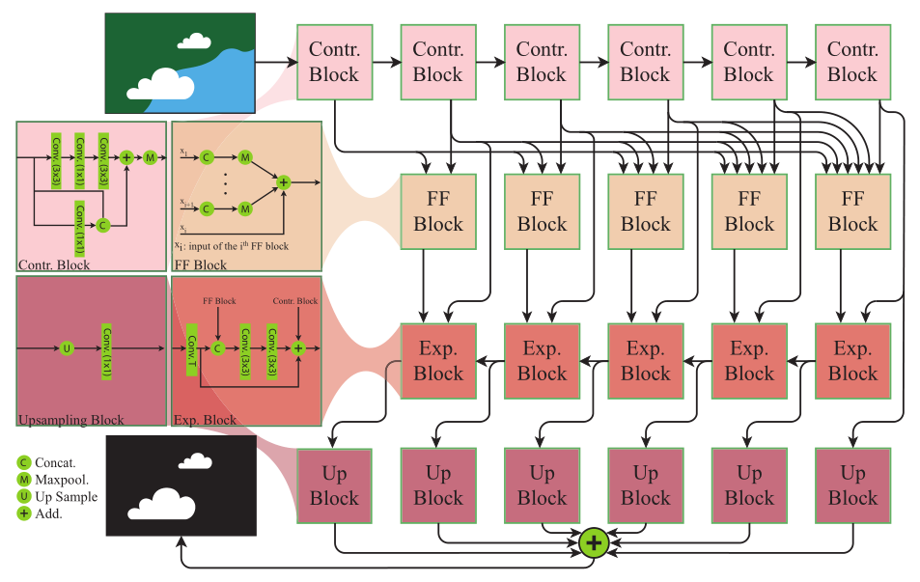
Network Architecture (Cloud-Net+)

Slide 3
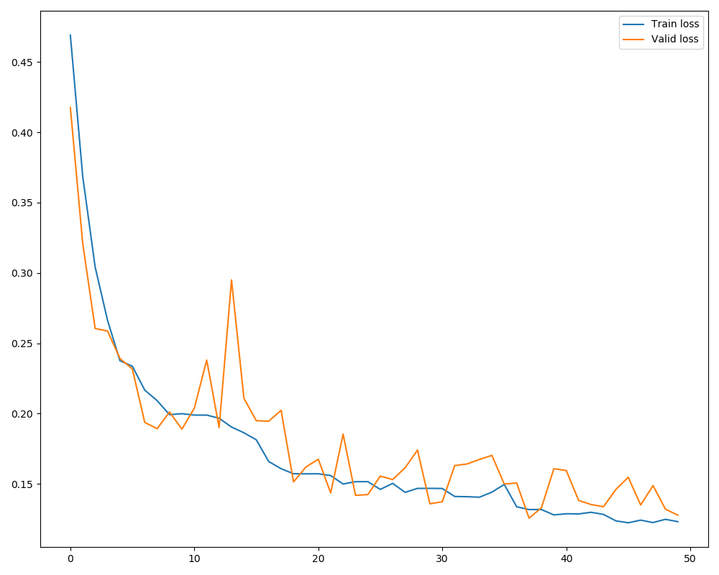
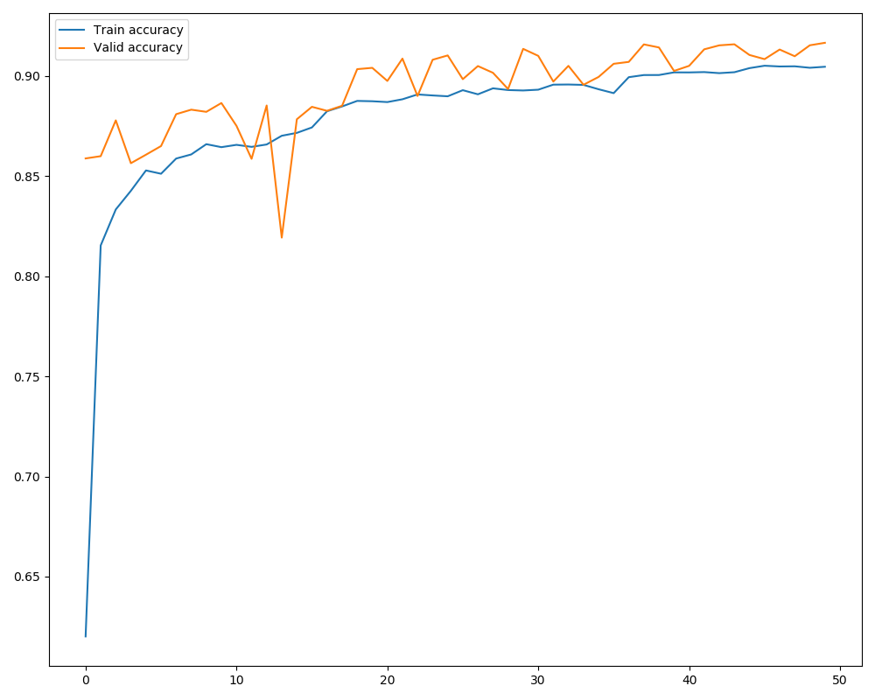
Loss and Accuracy: 95-Cloud dataset 50 epochs

Slide 4
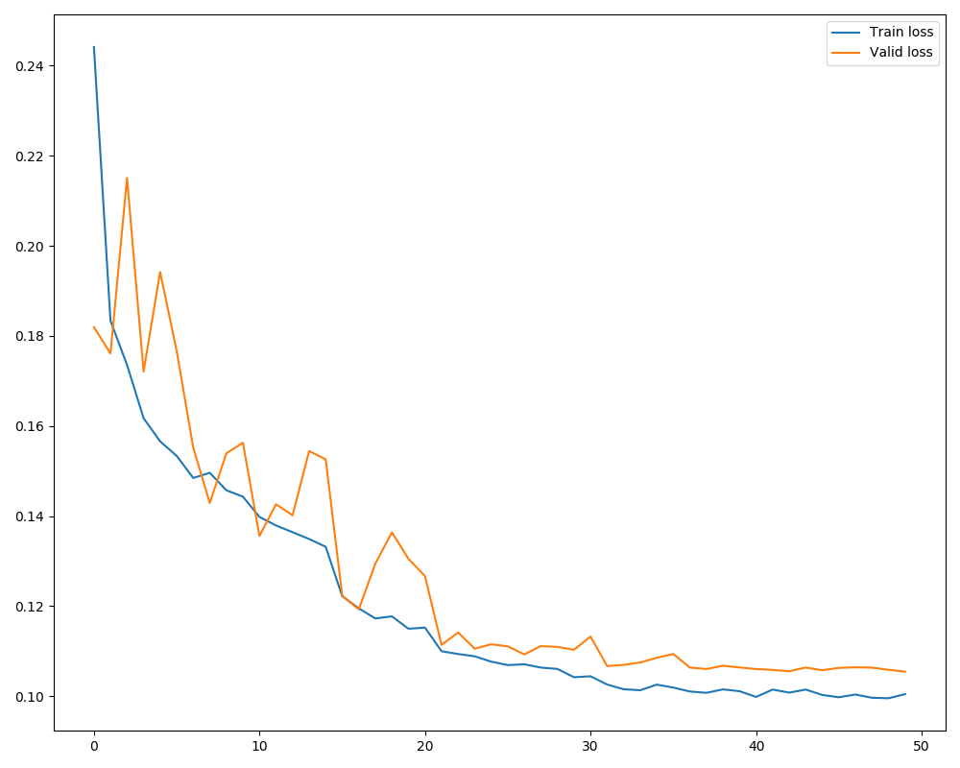
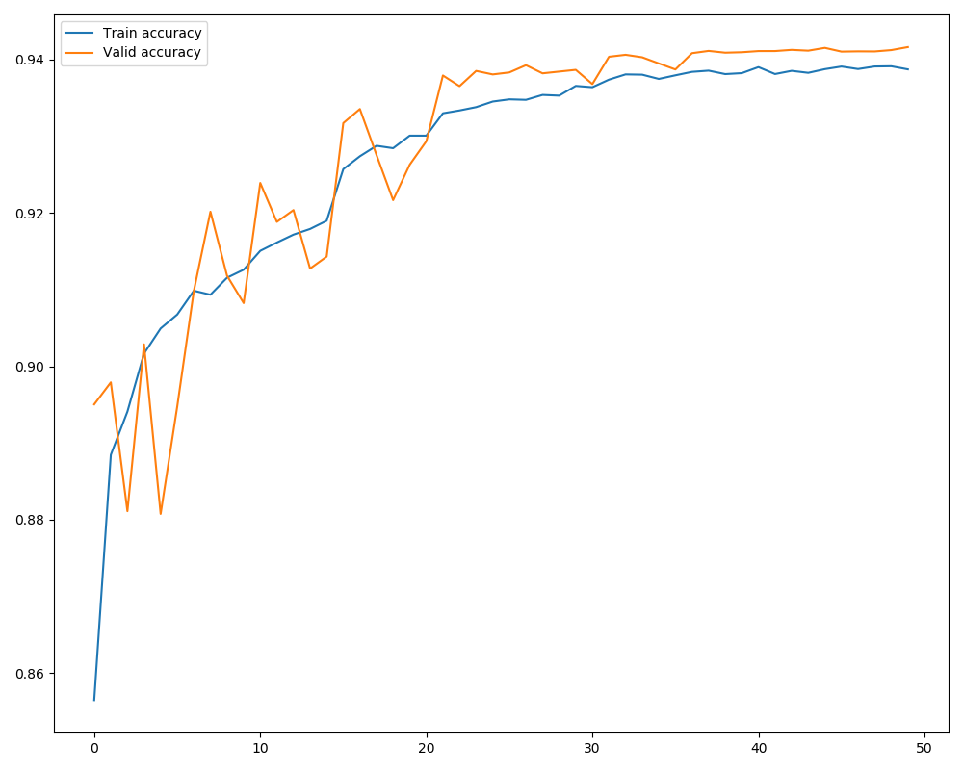
Loss and Accuracy: SWINySEG dataset 50 epochs

Slide 5
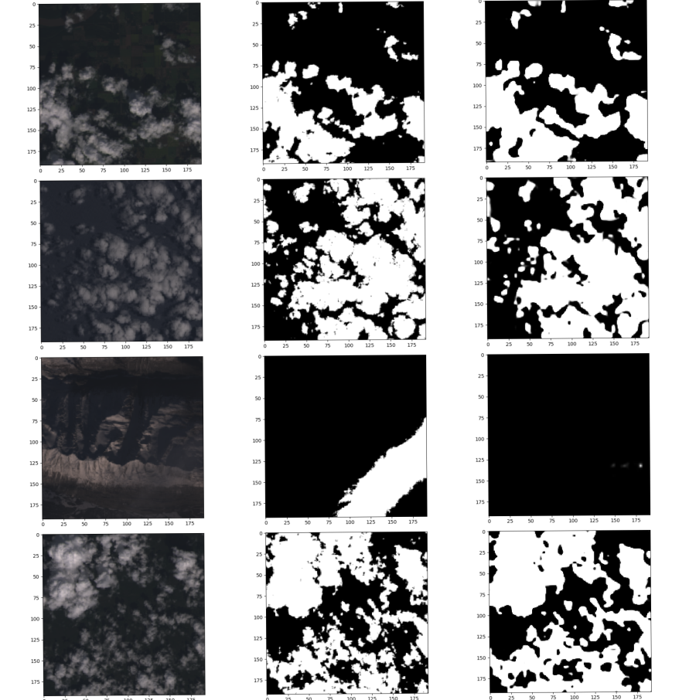
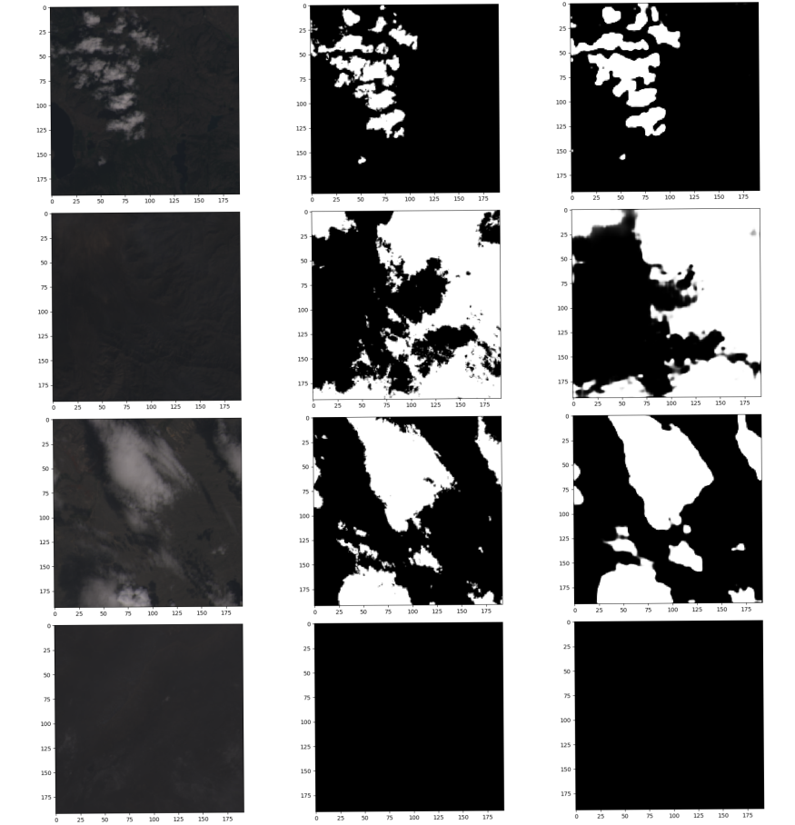
Segmentation on 95-Cloud Training data
Image | gt | Pred
Image | gt | Pred

Slide 6
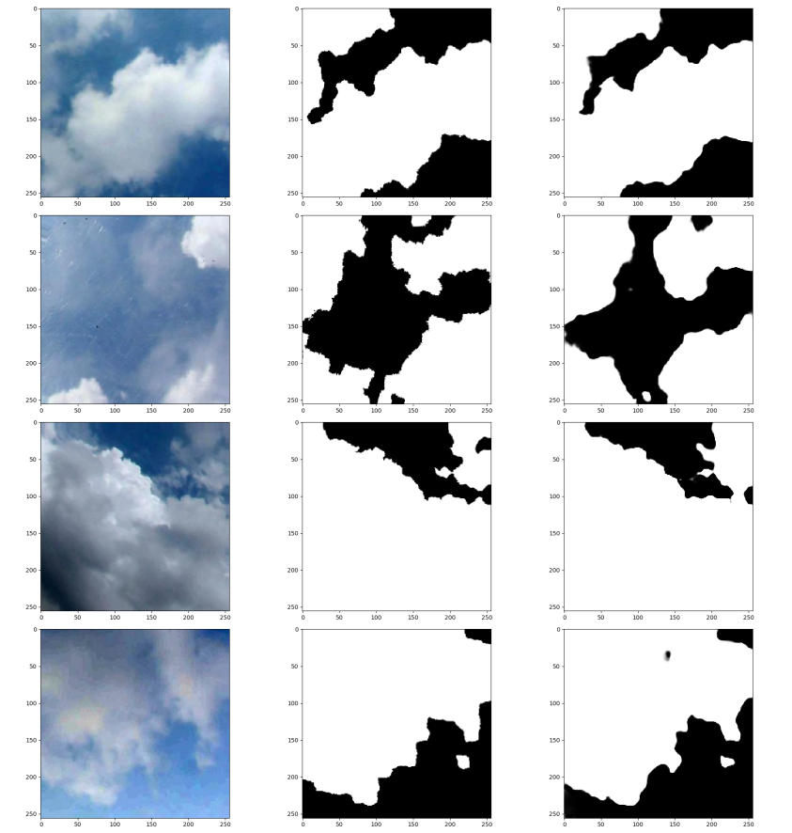
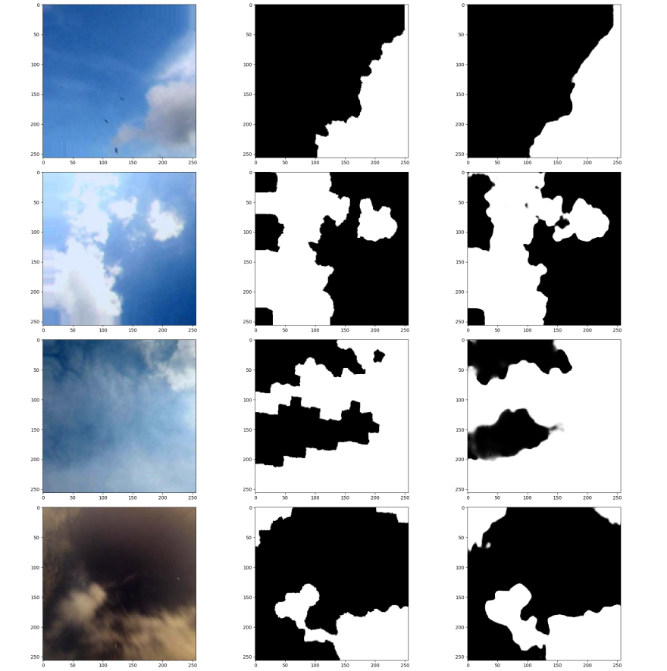
Segmentation on SWINGySEG Training data
Image | gt | Pred
Image | gt | Pred

Slide 7
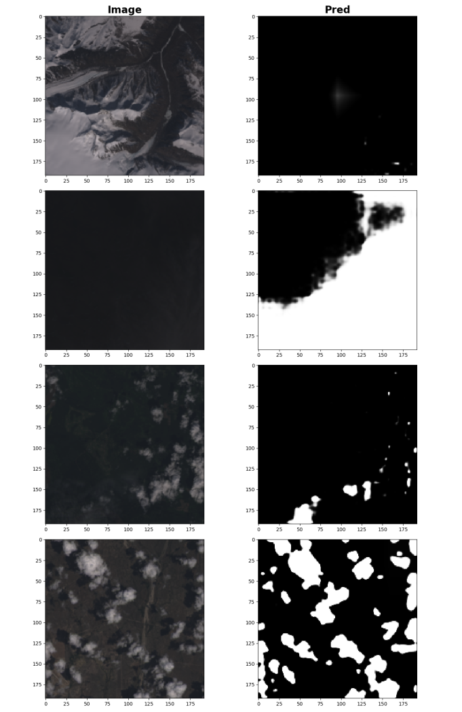
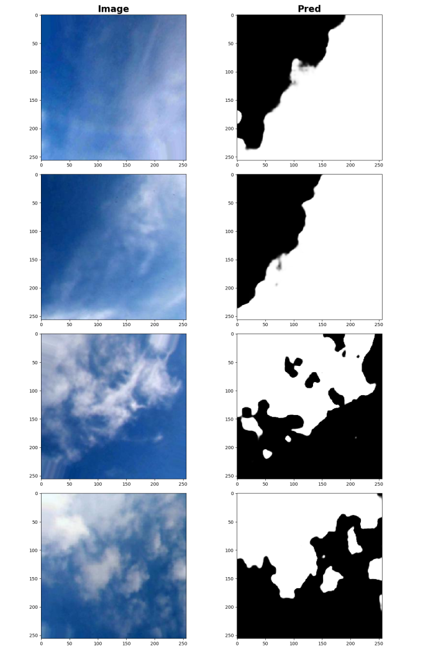
Segmentation – unseen images
95-Cloud
SWINySEG

